Slide 1
Database Modeling

Slide 2
Data modeling helps in understanding of the meaning of the data.
Data model is the collection of conceptual tools for describing the data, data relationships, the data semantics and data integrity constraints.
Data model is a means to present the designer’s understanding of the information needs of organization.
Model is the design of the database application.

Slide 3
Characteristics of Data Modeling
Integrity: The data model is such that integrity of the data i.e. no wrong data is allowed to enter in the database should be maintained.
Structural Validity: The model should be such that it can implemented in the database and all the organizational needs are fulfilled.
Express Ability : The model of the database should be as such it can express each data element and relationship clearly.

Slide 4
Non-Redundancy: The model of database as such that there should not be any redundant information in that.
Sharebility: The design should be as such it can be shared among various applications.
Extensibility: The design should be as such it can support new requirements without effecting the existing users.
Diagrammatic Representation: The design should be as such it can be represented easily using some notations.

Slide 5
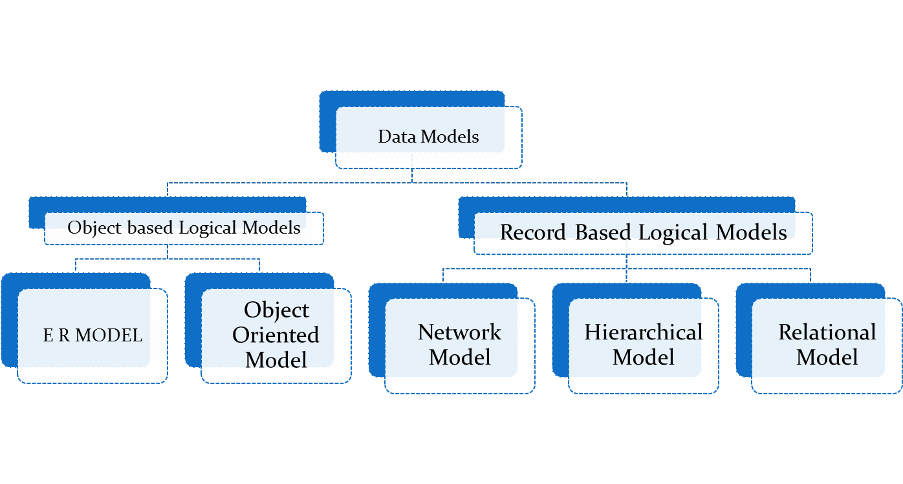
Classification of Data

Slide 6
Types Of Data Models
Record Based Logical Models : The database is organized in the fixed format records of several types. A fixed number of fields and attributes are there in records type and each field is usually of a fixed length.
There are three basic record based model:
Relational model
Network Model
Hierarchical Model

Slide 7
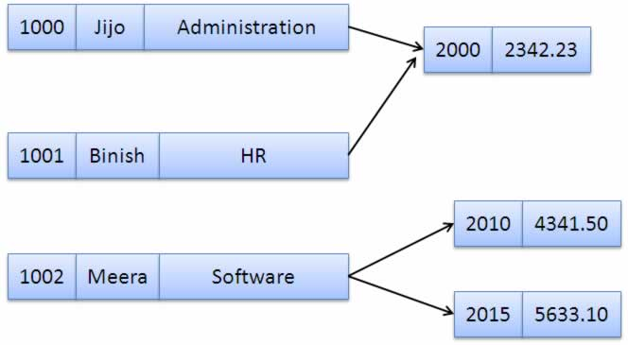
Network Model
Network model
Data is represented as collection of records and relationship by links.
The records are organized as generalized graph structures.
Relationship in this data model can be (1:N), (N:1) or (N:N)

Slide 8
Advantages of Network Model
Simplicity: The network Model is conceptually simple and easy to design.
Ability to handle more relationships: It can handle one to many and many to many relationship.
Ease of Data Access: If someone is accessing the owner record it can automatically access the member record because they exist in the set only.
Data Integrity : no wrong data can be entered in the database.
Data Independence : In this case the data and physical storage structure are independent of each other.

Slide 9
Disadvantages of Network Model
System Complexity: The Database designers has taken special care while designing the database because internal data storage are complex in nature.
Lack Of structural Independence : Any change in the structure of data needs to change the application program it provide data independence but does not provide the structure independence.

Slide 10
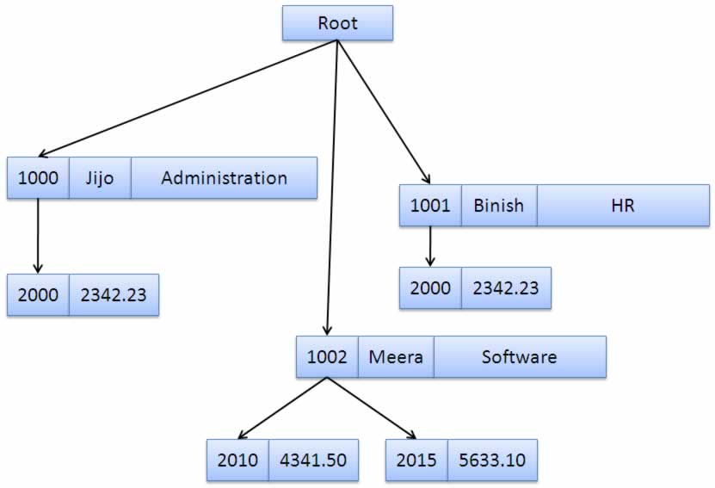
Hierarchical Model
It is one the oldest model of the database.
This model is like a structure of tree with records forming the nodes and fields form
the branches.
It organizes the data in a tree structure .
It works on parent child relationship (1:N).

Slide 11
x
Advantages of Hierarchical Model
Simplicity: since the database is based on hierarchical structure the relationship between various layers is quite simple . so design is quite simple.
Data security : Since it was the first model so it provide security.
Data integrity : since the model have parent child relationship . each child segment reference to the its parent segment so data integrity is maintained.
Efficiency: This Data model is efficient because it can support large number of relationships. (1:n relationship)

Slide 12
Disadvantages:
Implementation Complexibility : Although it is easy to design but it is quite complex to implement.
Database management problems : If any Change made in the database structure can lead to changes in application program so maintain the application and database become difficult in that case.

Slide 13
Lack of structural independence: If the structure of database changed it cause changes to the application also it that case no structural independence is there is hierarchical systems.
Programming complexibility : The hierarchical models are based on access paths it difficult for the programmer to design the application programs for this database.

Slide 14
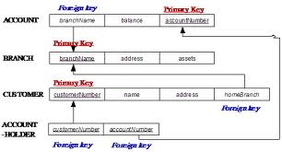
Relational model
Relational Model uses tables to represent the data and relationships.
Each table has multiple columns and each is indentified by a unique name.

Slide 15
Advantages of Relational Model
Structural Independence: changes made in structure of the data does not affect the data accessing strategy.
Simplicity : It the simplest of model of all because it
Designer have to be concentrated on the logical view rather then physical data storage.
Ease of design , implementation, maintenance and usage : It supports data independence and structure independence so it is easy to design ,implement and maintain the data.
Adhoc Query Capability : It is easy to work with queries in the relational model .

Slide 16
Disadvantages of Relational Model
Hardware Overheads : Hardware overheads are more in this model because it make simple implementation for the user.
Ease of Design can result in Bad Design :Ease in designing the database can result in bad design of the database which can lead to many problems .As the size of database increases several problems may occur like system slowdown, data corruption.

Slide 17
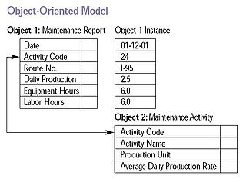
Object Oriented Model
It comprises of object and classes.
These object classes using programming language known as ODBMS.
Each class in this model is entity.

Slide 18
Advantages
Capability to handle more Data type: It can store text , numbers ,audio and video data into the database.
Combination of object oriented programming and database technology : both the features of the database as well as object oriented programming are clubbed in this model.
Object oriented features improve productivity: various features like inheritance , polymorphism improves productivity.
Data Access : Data access is quite easy in this casse of object oriented model.

Slide 19
Disadvantages
Difficult to maintain : changes made in the object oriented model are difficult to maintain one change bring lot of changes on the object oriented model.
Not suited for all application : It not suited for all application like for simple databases if it is uses there it degrades the peformance.

Slide 20
Other Data Model Or Physical Data Model
Object Relational Model:
Relational databases were the most successful technologies in computer science.But increasing modern needs to store multimedia data relational database were not sufficient so object infrastructure was added into the database.
The database management system using this structure is known to be as object relational database because it has capability to of relational database as well.

Slide 21
Deductive/interface model
This Database model is still in development which can deduce the rules based on facts that are stored in the database by the database designers and rules will be deduce by the end users using the database.

